Slide 1

Sant Gajanan Maharaj College Of Engineering
Mahagaon
Project Presentation on
“Adaptive Headlight and Emergency Brake Alert System”
By
Mr. Gunde Amey Rajendra Mr. Mutnale Sanket Basavraj Mr. Takkekar Aniket Tukaram
Guide
Prof. S. R. Sankpal
Electronics And Telecommunication
Project Co-Ordinator
Prof V. K. Salunke
Electronics And Telecommunication
HOD
Prof. A. B. Farakte
Electronics And Telecommunication

Slide 2

Outline
Problem Statement
Literature Survey
Relevance
Introduction
Objective
Block Diagram
Working
Conclusion
Reference
Outline:

Slide 3

Problem Statement
Develop an innovative adaptive headlight system to enhance nighttime driving safety and integrating emergency brake light flash for standardized signalling. Aimed at reducing accidents, improving communication, and promoting cost-effective integration in vehicles for overall road safety and driver comfort.

Slide 4
.Literature Survey
.Literature Survey
This study uses the BH1750 module as the main component to detect other vehicles facing in front of it.
2. This study also used the MPU6050 module to assess road contours.
3. In laboratory testing, the MPU6050 module as an accelerometer, the BH1750 module as a lux meter, MG995 Servo Motor movement testing and overall tool testing is tested.
- Dzulfiqar Dwi Yanto[2020]

Slide 5
.Literature Survey
This paper is aimed to design and perform a smart vehicle headlights control system to adjust vehicle headlights automatically according to the surrounding lighting condition.
The system device automatically switches the headlight to low beam when it senses a vehicle approaching from the opposite side using Light Dependent Resistor (LDR) sensor.
Automatic headlight intensity beam is controlled by using photo transistor and XBee, which is not efficient for measure the intensity of light.
- Arpita K [2018]

Slide 6
.Literature Survey
The article found by increasing the age of the driver, a significant decrease in brake reaction time is observed (11.58 ms).
2. the flashing brake lights were used to decrease the driver’s brake reaction time and prevent the rear-end collisions.
By using flashing brake lights with a frequency of 7 Hz, the brake reaction time decreased 323.42 ms.
- Mohammd Sadegh Sohrabi [2019]

Slide 7
Relevance
Traditional headlight systems contribute to nighttime driving accidents.
Glaring high beams from oncoming vehicles are a common challenge for nighttime drivers.
The use of high beams on highways inconveniences opposite-direction traffic.
Driver actions play a significant role in accidents.
Closely observing brake lights helps drivers become aware of potential hazards.
Rear-end collisions often result from inattentiveness or delayed reactions.

Slide 8
Introduction
Glare
Road Curvature
AHS (Adaptive Headlight System)
Outline:

Slide 9
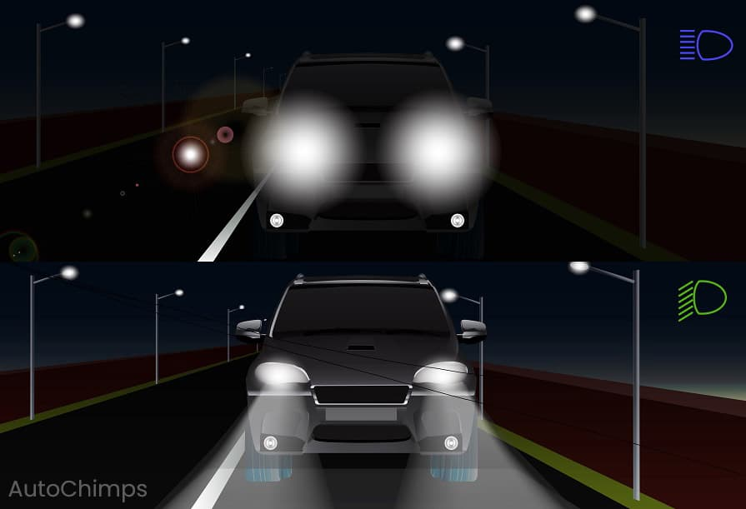

Slide 10
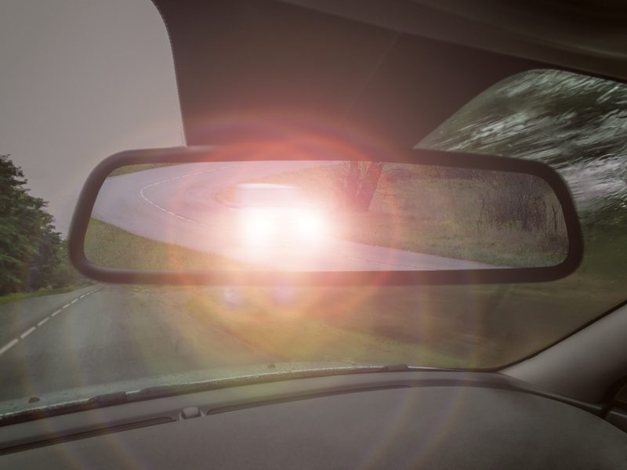
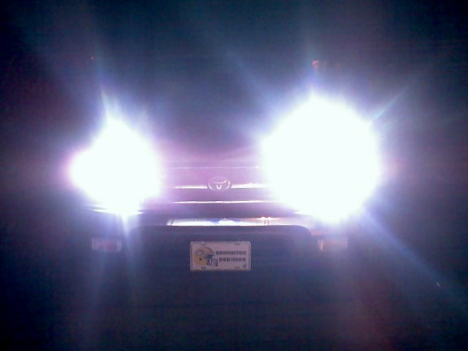
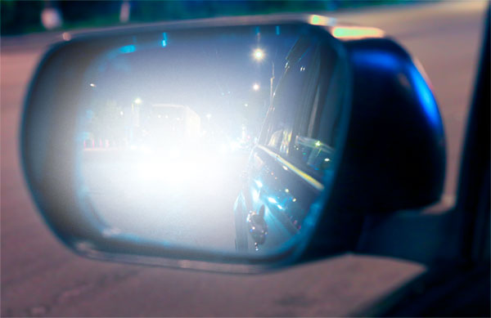

Slide 11
Introduction
Rear-end Collision
Drivers Response Time
EBL (Emergency Brake Lights)
Outline:

Slide 12
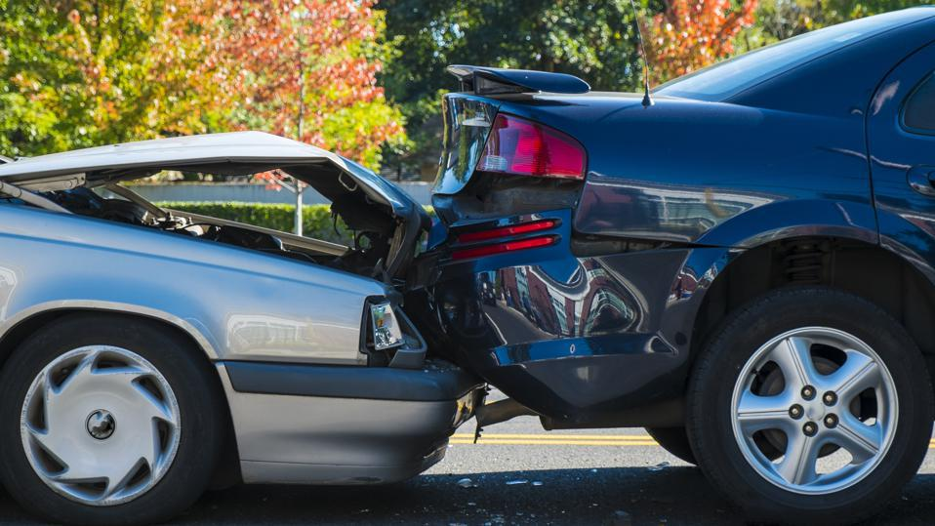
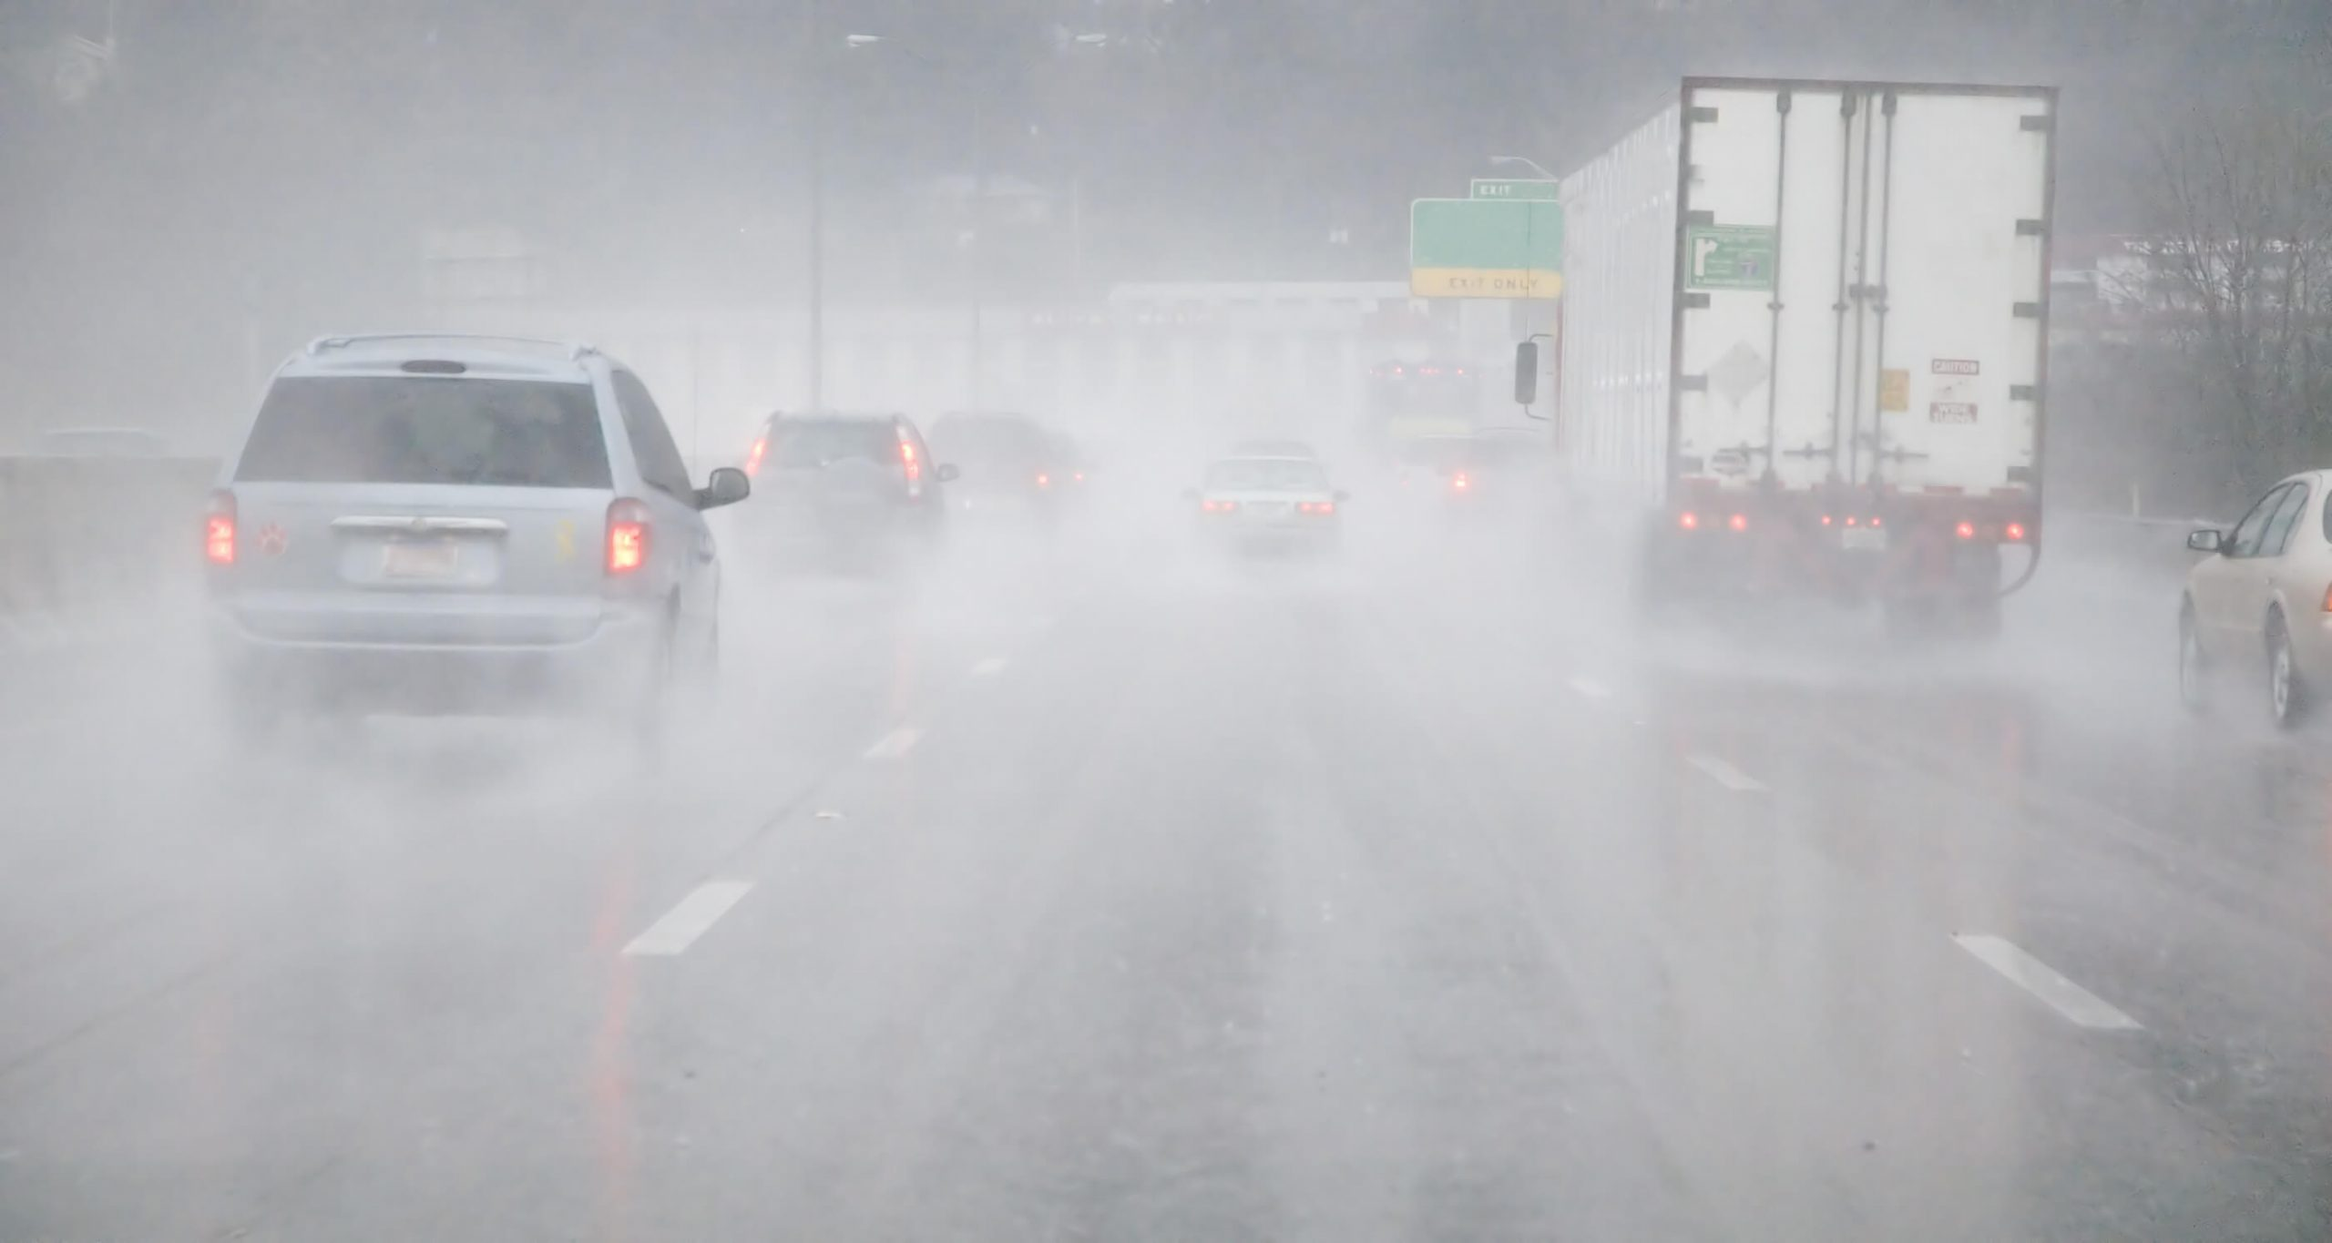
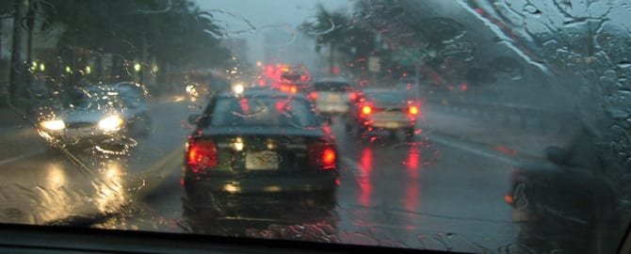
Introduction
Rear-end Collision
Drivers Response Time
EBL (Emergency Brake Lights)

Slide 13


Slide 14
Objectives
Enhance Nighttime Safety
Minimize Glare
Adapt to Road Curvature
Enhance Rear-End Collision Prevention
Adapt to Braking Severity
Integrate with Existing Brake Lights
Outline:

Slide 15
Block Diagram
Power Supply
Light Sensors
Microcontroller Unit
Emergency Brake Sensor
Stepper Motors
Speedometer
Headlight Assemblies
Brake Light Flasher Unit
Matrix lights
Brake Lights
Manual Controllers

Slide 16
Working
Microcontroller Unit (MCU)
Light Sensors
Stepper Motors
Headlight Assemblies
Matrix Lights
Emergency Brake Sensor
Speedometer
Brake Light Flasher Unit
Brake Lights

Slide 17
Conclusion
Enhanced Nighttime Safety
Minimized Glare
Improved Road Curvature Adaptation
Enhanced Rear-End Collision Prevention
Differentiated Brake Light Response
Seamless Integration with Existing Brake Lights

Slide 18
References
[1] Dzulfiqar Dwi Yanto et al “Design of Automatic Headlight Based on Road Contour and Other Headlight Light” Conference: 2020 2nd International Conference on Industrial Electrical and Electronics (ICIEE) October 2020.
[2] Arpita K et al “Automated Headlight Intensity Control and Obstacle Alerting System” ternational Journal of Engineering Research & Technology (IJERT) ISSN: 2278-0181 Published by, www.ijert.org NCESC - 2018 Conference Proceedings Special Issue – 2018.
[3] Surej Mouli et al “Investigating the Cognitive Response of Brake Lights in Initiating Braking Action Using EEG” IEEE TRANSACTIONS ON INTELLIGENT TRANSPORTATION SYSTEMS, VOL. 23, NO. 8, AUGUST 2022.
[4]Mohammad Sadegh Sohrabi “Effects of Flashing Brake Lights on Drivers’ Brake Reaction Time and Releasing Accelerator Gas Pedal Time” Health in Emergencies and Disasters Quarterly. 2019.

Slide 19

THANK YOU…
THANK YOU…

